Slide 1

AI Powered Crop Yield
Al-Powered Crop Yield Prediction and Optimization
Name of the Candidates: 1. Niranjan Thorave A-19
2. Ojas Patil A-20
3. Om Nathe A-21
4. Omsai Gunale A-22
Name of the Guide: Dr. Manisha Khadse
DEPARTMENT OF Artificial Intelligence and Data Science
PCET’s Pimpri Chinchwad University
Established under Govt. of Maharashtra Act No. V of 2023
Gut No. 44, 46, 48, 49 and 50, Sate, Maval (PMRDA) Dist. Pune-412106 Maharashtra, India

Slide 2
Contents of the Presentation
Details
Details
Outline
Aim
Problem Statement
Objectives
Literature Survey Identified base papers (list atleast 5)
Methodology
Results
Conclusion
Future scope
Bibliography (all the papers referred)
No. of slides
No. of slides
01
01
01
01
04
02
01
01
01
02
Outline
Aim
Problem Statement
Objectives
Literature Survey Identified base papers (list atleast 5)
Methodology
Results
Conclusion
Future scope
Bibliography (all the papers referred)

Slide 3
A I M
To develop and explore AI-powered approaches for accurate crop yield prediction and agricultural optimization, thereby enabling sustainable farming practices, resource efficiency, and improved food security.

Slide 4
PROBLEM STATEMENT
Traditional crop yield estimation methods are inaccurate and resource-intensive, highlighting the need for AI-powered solutions that enable accurate prediction and sustainable optimization in agriculture.

Slide 5
OBJECTIVES
Quantitative Objectives
Achieve highest yield prediction accuracy using multimodal AI
Reduce RMSE and MAE vs baseline models.
Improve water/fertilizer planning using adaptive predictions.
Qualitative Objectives
To explore the role of Artificial Intelligence in enhancing precision agriculture and sustainable farming.
To design an AI framework that provides adaptive and intelligent recommendations for farmers.
To integrate explainable AI techniques that make predictions interpretable for non-technical users.
To encourage data-driven decision-making in crop management, reducing dependency on traditional practices.

Slide 6
INTRODUCTION
Agriculture today faces significant challenges due to:
Irregular rainfall and climate variability
Decreasing soil quality
Higher food demand
Uncertainty in crop performance
Artificial Intelligence (AI) provides:
Real-time monitoring
Data-driven insights
Early prediction of crop yield
Support for precision agriculture and smart farming
CANF is an advanced AI approach that integrates weather, soil, and crop imagery to deliver highly accurate and climate-resilient yield predictions.

Slide 7
LITERATURE REVIEW
Sr. No | Paper Title / Year | Methodology / Observation | adv | dis | Finding (Method / dataset / result) | Remarks / future work
1 | Artificial Intelligence in Agriculture: A Systematic Review of Crop Yield Prediction and Optimization (IEEE Access, 2025) | Systematic Literature Review using PRISMA: 776 records → 25 studies. Compares KNN, SVM, RF, XGBoost, DL, identifies key variables (soil, climate, crop traits) and metrics (RMSE, MAE, R², MAPE). | Comprehensive map of algorithms, features, and metrics; highlights trends and gaps; open-access. | Secondary (no new experiments); heterogeneous datasets limit comparability. | Findings: Broad evidence that ML/DL improves yield prediction; features: soil/climate dominate; metrics: RMSE/MAE standard. | Calls out data quality, pre-processing, and model complexity as key challenges; urges better generalization and standardized evaluation.

Slide 8
LITERATURE REVIEW
Sr. No | Paper Title / Year | Methodology / Observation | Adv | Dis | Finding (Method / dataset / result) | Remarks / future work
2 | An efficient algorithm for predicting crop using historical data and pattern matching technique (Global Transitions Proceedings, 2021) | Builds regional crop recommendation using historical weather/soil (rainfall, temperature, slope, humidity, soil moisture), IMD Pune data; processing with Xarray; pattern-matching over 50-year monthly aggregates. | Simple, fast; high reported accuracy; practical for farmer decisions at sowing time. | Limited to Karnataka; generalization beyond region untested; UI/device issues referenced in related work review. | Dataset: IMD + curated crop list (20 crops). Results: up to 98% accuracy vs baselines (DT, NB, KNN, LR, ANN at 76–95%). Uses PR/FPR for validation. | Future: scale to national coverage; add geospatial analysis; include regional languages in UI.

Slide 9
LITERATURE REVIEW
Sr. No | Paper Title / Year | Methodology / Observation | adv | dis | Finding (Method / dataset / result) | Remarks / future work
3 | A proposed framework for crop yield prediction using hybrid feature selection approach and optimized machine learning(Neural Computing and Applications (2024)(Springer) | Proposes a hybrid feature selection and ICOA to tune SVR hyperparameters for yield prediction. Extensive experiments benchmark against SOTA. | Higher accuracy and computational efficiency than baselines; clear ablation of feature selection + optimization. | Added complexity; requires careful parameterization and may be compute-intensive for edge devices. | Findings: Optimized-SVR outperforms competing models on standard error metrics (RMSE/MAE/MAPE reductions). | Suggests extending to other crops/regions and exploring DL hybrids and real-time deployment.

Slide 10
LITERATURE REVIEW
Sr. No | Paper Title / Year | Methodology / Observation | adv | dis | Finding (Method / dataset / result) | Remarks / future work
4 | AI-Powered Predictive Analytics for Crop Yield Optimization (Book chapter in Agriculture 4.0, 2024)(ResearchGate) | Narrative/mini-review: integrates AI + IoT pipelines, DSS, and policy/ethics; compiles recent studies across sensors, ML/DL, and optimization. | Holistic view (tech + adoption + ethics); practical guidance on training, infrastructure, and responsible AI. | Not an empirical benchmark; relies on secondary sources; limited quantitative comparison. | Finding: Success of predictive analytics depends on connectivity, usability, and governance in addition to models. | Recommends capacity building, rural connectivity, and ethical frameworks to scale AI benefits inclusively.

Slide 11
LITERATURE REVIEW
Sr. No | Paper Title / Year | Methodology / Observation | adv | dis | Finding (Method / dataset / result) | Remarks / future work
5. | Agentic AI for Pathogen-Based Plant Disease Detection (IEEE, 2025) | proposes Agentic AI framework that integrates autonomous decision-making, continuous learning, and explainable AI for pathogen-based disease detection. | Provides proactive, self-learning, and interpretable predictions. Reduces pesticide use, improves early detection, increases farmer trust. | Requires large multimodal datasets; edge deployment challenges; ethical and access concerns for small-scale farmers. | Findings: High accuracy in early disease detection, reduction in pesticide use, and improved yield sustainability. | Future work: swarm robotics, blockchain for traceability, federated learning for cross-region adaptability.

Slide 12
LITERATURE REVIEW
Sr. No | Paper Title / Year | Methodology / Observation | adv | dis | Finding (Method / dataset / result) | Remarks / future work
6. | AI for Sustainable Agriculture: Smart Farming Solutions (IEEE, 2024) | Comprehensive review of AI in precision farming, yield prediction, irrigation optimization, pest/disease management, and climate resilience. | Holistic coverage of AI + IoT + robotics; shows measurable sustainability gains; highlights policy & ethical aspects. | High implementation cost (drones, sensors); data privacy and smallholder farmer accessibility issues; regulatory barriers. | Findings: AI enables 25% water savings in Israel, 20% fertilizer reduction in India, and yield increase in Europe. Supports climate adaptation with predictive algorithms. | Future work: policy support, farmer training, democratization of AI tools; more climate-resilient algorithms for developing regions.

Slide 13
Research Gaps in Existing Literature
No Adaptive Fusion: Existing models give equal importance to all inputs, even during climate stress, leading to inaccurate predictions.
Poor Multimodal Integration: Most systems use only one data type (weather, soil, or imagery) instead of combining all three for better accuracy.
Lack of Explainability: Models behave like black boxes, offering no clarity on which factors influence yield, reducing farmer trust.
Weak Climate Robustness: Accuracy drops heavily during droughts, heatwaves, or abnormal weather patterns.
Limited Real-World Deployability: Many models are too heavy to run on low-power devices like Raspberry Pi, restricting field-level usage.
No Support for Continuous Adaptation: Models do not adjust to seasonal or regional variations unless manually retrained.

Slide 14
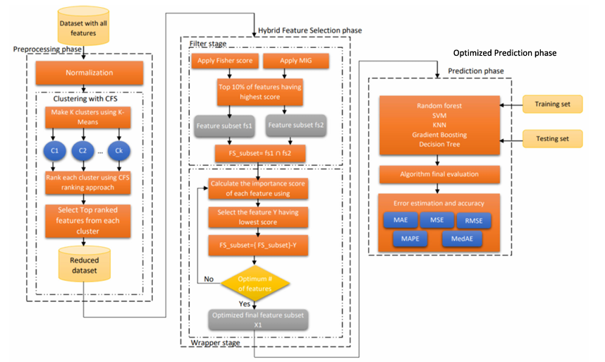
Existing Methodology
Phase | Method / Technique | Purpose / Outcome
1. Data Preprocessing | Normalization, K-Means Clustering, CFS | Prepare clean data, remove noise, reduce redundancy
2. Feature Reduction | Cluster-wise CFS Ranking | Select top-ranked features from each cluster
3. Hybrid Feature Selection | Fisher Score, Mutual Information Gain, RFE-SVM | Identify most relevant features for accurate prediction
4. Model Optimization | Improved Crayfish Optimization Algorithm (ICOA) | Tune ML model parameters for best performance
5. Prediction | SVR, RF, KNN, Gradient Boosting, DT | Train and generate crop yield predictions
6. Evaluation | MAE, RMSE, R², MAPE | Validate model accuracy and reliability

Slide 15
Proposed Methodology
Phase | Technique Used | Purpose / Outcome
1. Data Preprocessing | Weather smoothing, Soil normalization, Image resizing & augmentation | Prepare clean, consistent inputs for all three modalities
2. Feature Engineering | Degree-days, Cumulative rainfall, Vegetation indices (NDVI/EVI), Heatwave counts | Extract meaningful features for improved model understanding
3. Multimodal Encoding | LSTM (weather), Dense NN (soil), CNN (imagery) | Learn temporal, numeric, and spatial features from each data type
4. Adaptive Fusion Mechanism | Softmax-based dynamic weighting, Context network | Assign importance to each modality based on climate conditions
5. Model Training | Multimodal Deep Learning, Adam optimizer, Early stopping | Train CANF to accurately predict crop yield in diverse climate zones
6. Evaluation | RMSE, MAE, MAPE, R² | Compare model performance with baseline models and validate accuracy
7. Explainability | SHAP Analysis | Provide feature-level and modality-level interpretability for farmers
8. Deployment | Model pruning, Quantization, Edge–Cloud integration | Enable real-time on-field prediction using low-power devices

Slide 16
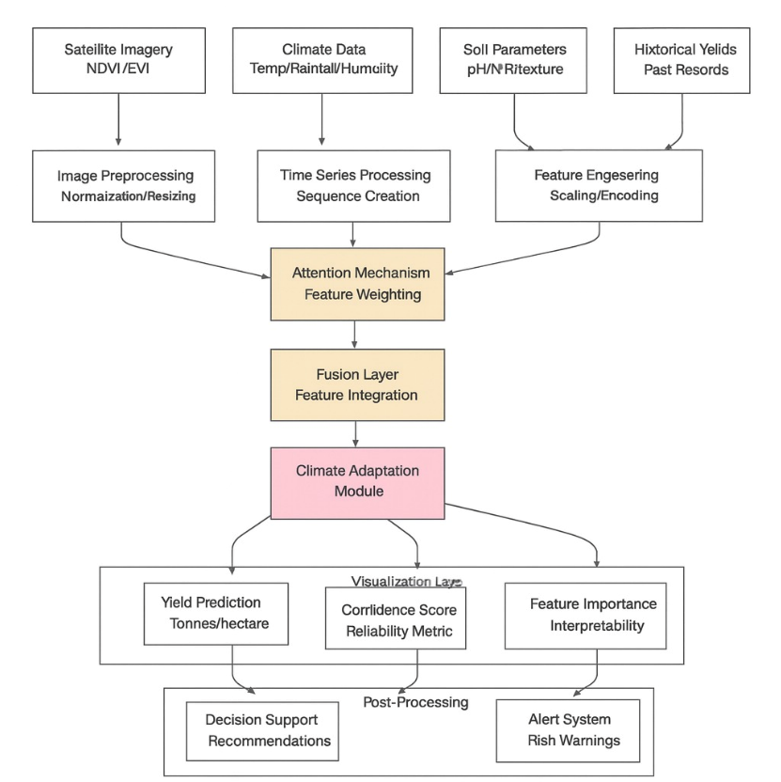
Proposed Methodology

Slide 17
Results
Model / Technique | Mean Accuracy | Max Accuracy | MAE | RMSE | R² Score | Rank / Remarks
Random Forest (RF) | 0.845 | 0.853 | 0.215 | 0.242 | 0.87 | Moderate performance
1D Convolutional Neural Network (CNN) | 0.912 | 0.924 | 0.168 | 0.201 | 0.91 | Good performance
LSTM–DBN Hybrid Model | 0.903 | 0.914 | 0.172 | 0.195 | 0.90 | Stable and accurate
CYPA (Crop Yield Prediction Algorithm) | 0.925 | 0.939 | 0.153 | 0.188 | 0.93 | Strong baseline
FMIG–RFE–SVM + ICOA | 0.943 | 0.949 | 0.138 | 0.171 | 0.95 | Top performer
Proposed Methodology | under observation | under observation | under observation | under observation | under observation | under observation

Slide 18
Conclusion
CANF provides a modern, intelligent, and climate-adaptive solution for crop yield prediction
Multimodal fusion significantly enhances accuracy
Explainability improves transparency and trust
Edge deployment ensures real-world usability
Supports sustainable and high-performance agriculture

Slide 19
Future Scope
Integration with IoT & Sensors: Use real-time soil and weather sensors to continuously update the prediction model.
Use of Multimodal Transformers: Adopt transformer-based architectures to improve cross-modal learning for weather, soil, and imagery.
Federated Learning for Privacy: Enable decentralized model training across regions without transferring farmer data.
Mobile Application for Farmers: Create an app that gives farmers instant yield prediction, crop health alerts, and smart suggestions.
Sustainability-Focused Optimization: Include water usage, fertilizer consumption, and carbon footprint as additional prediction factors.
Blockchain for Transparency: Track agricultural operations securely to ensure trust and verify recommended practices.

Slide 20
References
2025 6th International Conference on Artificial Intelligence, Robotics, and Control Agentic AI for Pathogen-Based Plant Disease Detection
AI for Sustainable Agriculture: Smart Farming Solution
Artificial Intelligence in Agriculture: A Systematic Review of Crop Yield Prediction and Optimization
Global Transitions Proceedings journal homepage: http://www.keaipublishing.com/en/journals/global-transitions-proceedings/ An efficient algorithm for predicting crop using historical data and pattern matching technique

